Slide 1

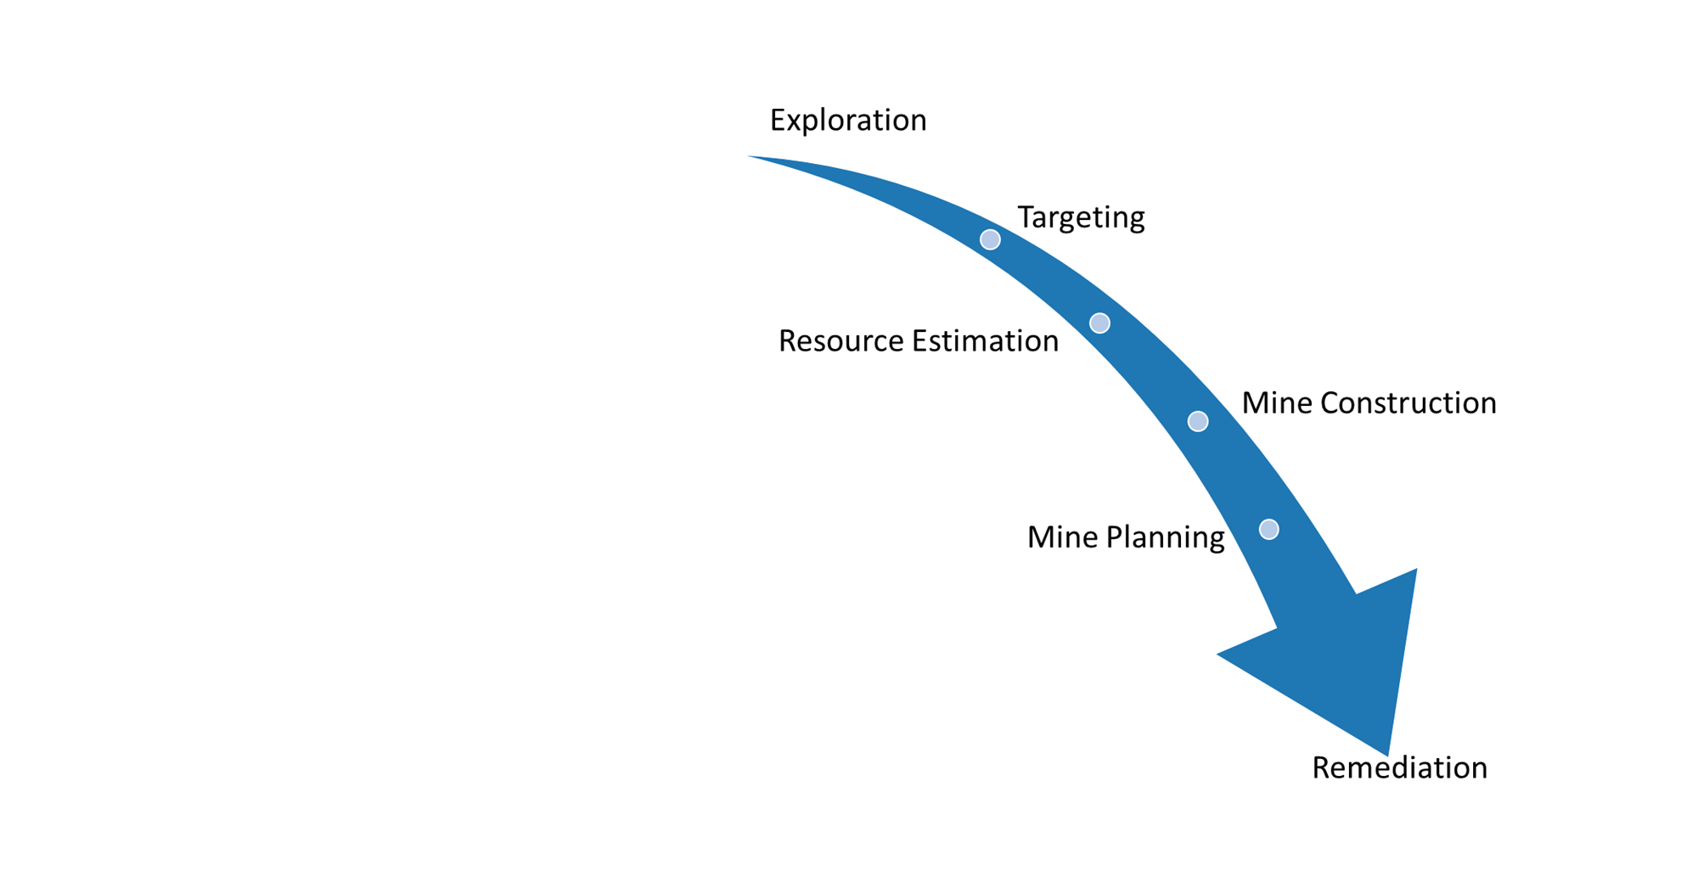

3D Geological Modelling Use cases
Mark Jessell
Notes:
The University of Western Australia acknowledges that it is situated on Noongar land, that the Noongar people remain the spiritual and cultural custodians of their land and continue to practise their values, languages, beliefs and knowledge.
Welcome……

Slide 2
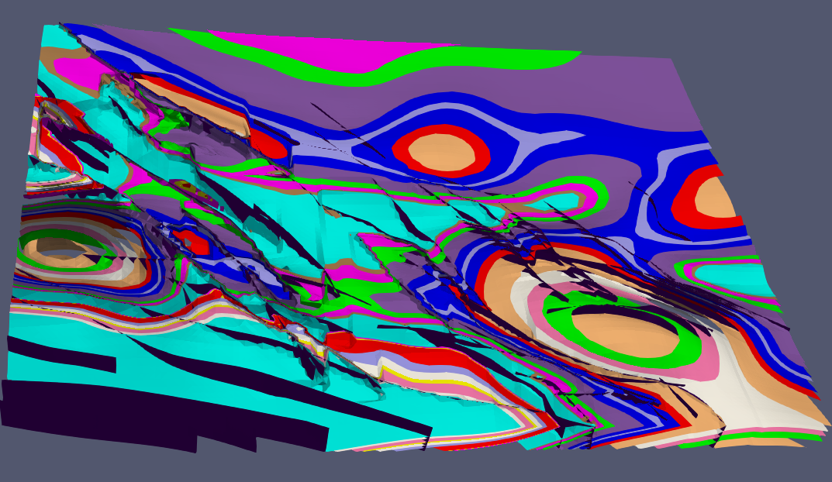
Major 3D modelling scenarios
Engineering
Waste storage
Hazards
Oil & Gas
Understanding fundamental processes
Mineral Resources

Slide 3
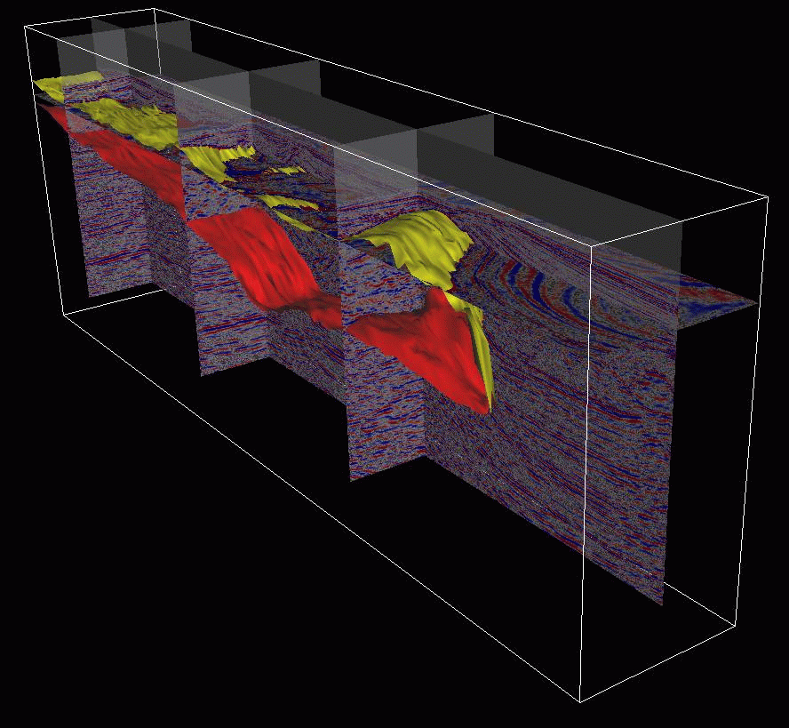
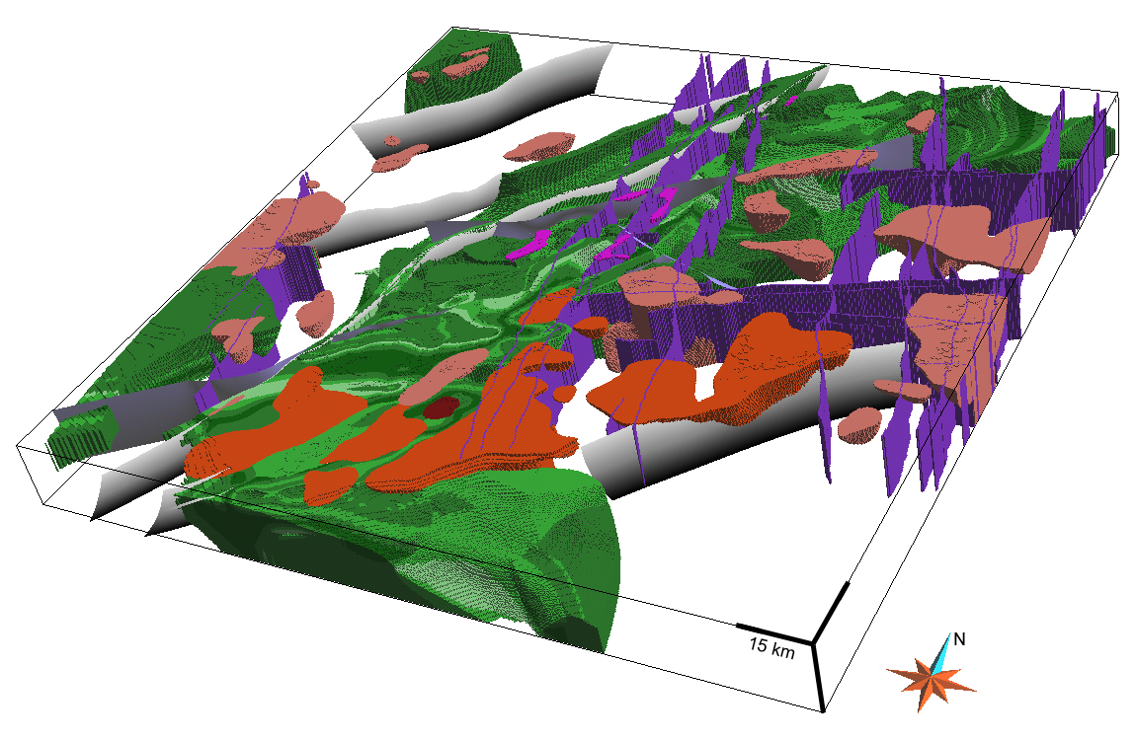
3D geomodelling scenarios
 | Sedimentary Basins | Mines | Regional | Lithosphere | Engineering
3D Constraints | RICH (3D seismic, deep boreholes, gravity) | RICH (dense boreholes, magnetics, seismic, electromagnetics) | POOR (rare boreholes, surface outcrops, gravity, magnetics) | RICH (Teleseismic, seismic, gravity, MT) | Rich (GPR, drillholes)
Structural Complexity | SIMPLE(R) | COMPLEX | COMPLEX | SIMPLE(R) | SIMPLE(R)
Dedicated Software | Gocad 1989, Geomodeller 1999… | MicroMine 1986, Leapfrog 2003... | Noddy 1981, Gocad-Sparse 1995, Geomodeller 1999, GemPy 2019, LoopStructural 2020 | Gocad 1989 | Dassault Systèmes

Slide 4
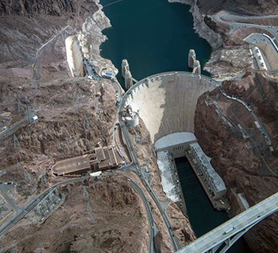

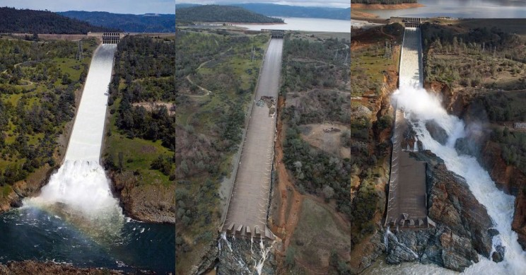
Why study 3D Geology?
Structural support: buildings, tunnels, bridges, dams, urban geology
So we need to be able to model mechanical properties (bulk strength, shear strength
But also permeability
wikipedia

Slide 5
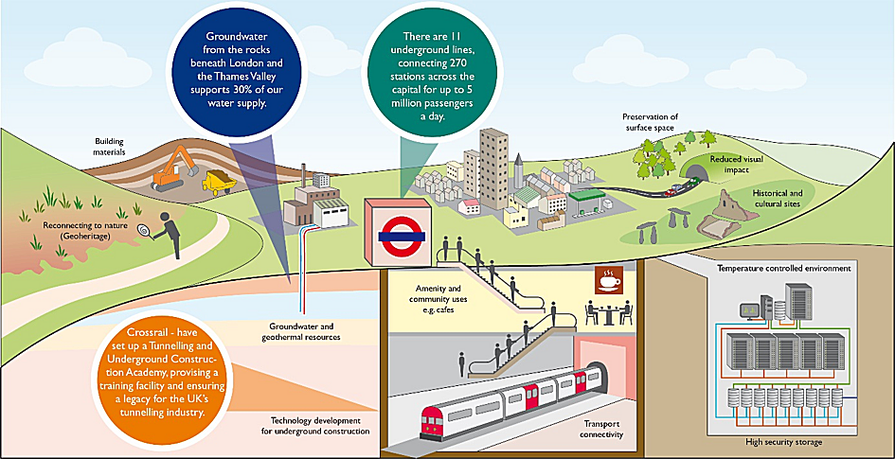

3D Urban
Geology
Groundwater from the rocks beneath London and the Thames Valley supports 30% of the water supply
There are 11 underground lines connecting 270 stations across London
So we need to be able to model mechanical properties (bulk strength, shear strength
But also permeability
Preservation of surface space
Building
Materials
Reduced visual impact
Historical and cultural sites
Reconnecting to nature
(Geoheritage)
Temperature controlled environment
Amenity and community uses e.g. cafes
Crossrail have set up a Tunnelling and Underground Construction Academy
Groundwater and Geothermal resources
Technology development for underground construction
Transport Connectivity
High security storage

Slide 6
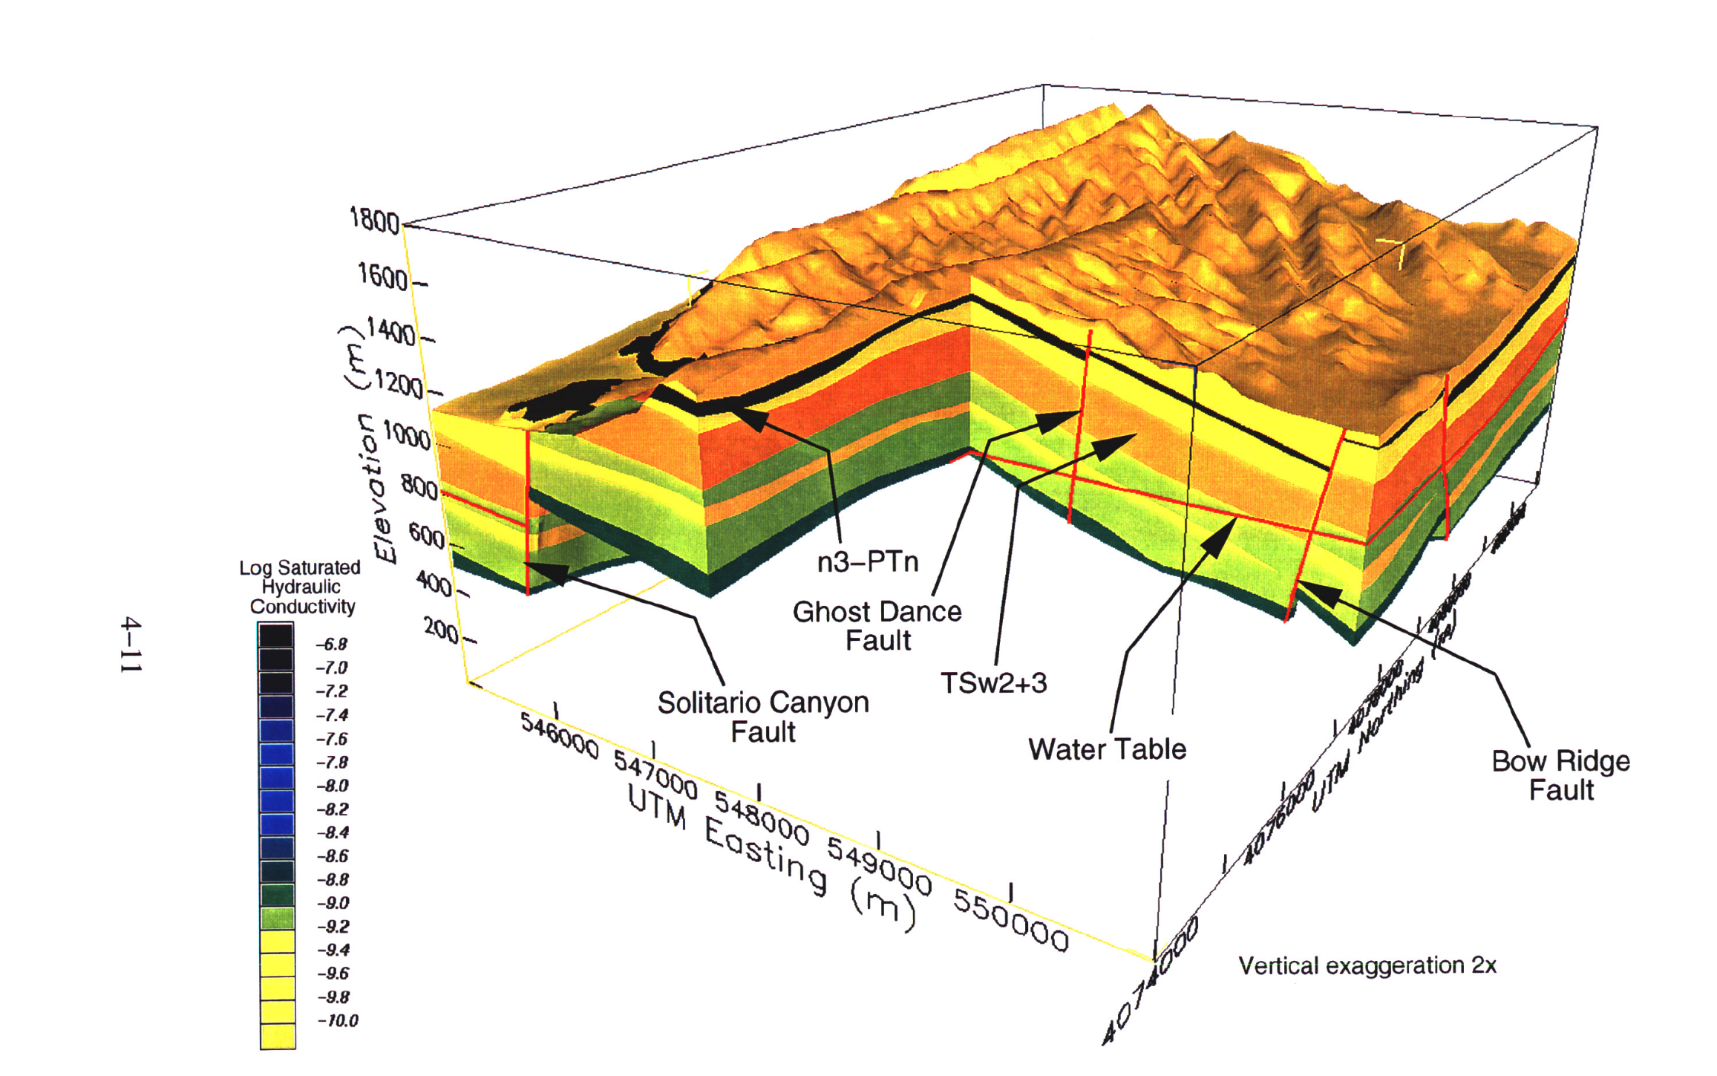
Stirewalt and Henderson,
1995
Waste disposal
So we need to be able to model mechanical properties (bulk strength, shear strength
But also permeability
G. Stirewalt and B. Henderson, 1995, A Three-dimensional Geological Framework Model for Yucca Mountain, Nevada, with Hydrologic Application: Report to Accompany 1995 Model Transfer to the Nuclear Regulatory Commission

Slide 7
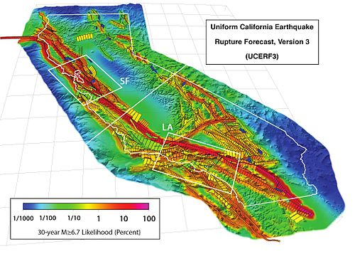
Why study 3D Geology?
Hazard: earthquakes, volcanoes, landslides
Eckert, Lui, Connolly 2015

Slide 8
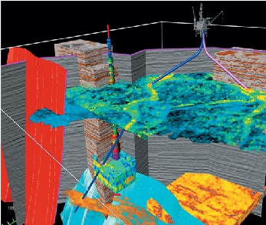

Sedimentary Basins
So we need to be able to model:
Distributions of lithology, stratigraphy
Mechanical properties: bulk strength, shear strength
Density
Porosity-Permeability in 4D
Fault network
Grain size

Slide 9
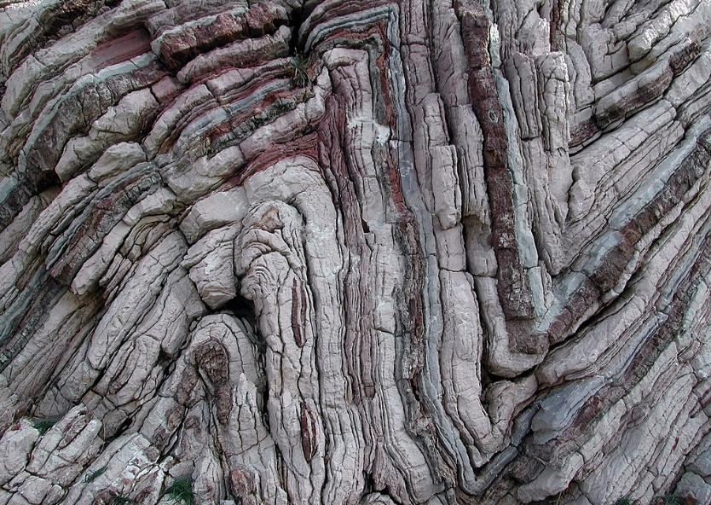
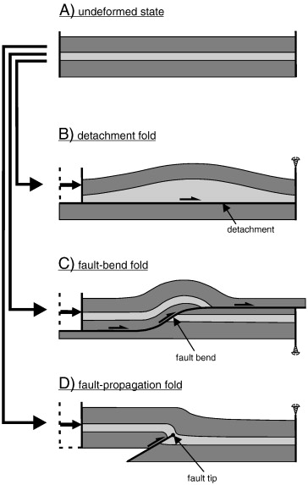
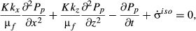
Science: geometry->kinematic->dynamic->processes
Assumed Process Model
x=17.5, y=140.0, z=-240.0
Equation connecting stress and strain
x=x-δx, y=y, z=z+sin(x)
Diffusion equation for the pore pressure, P _{P} , is given by:
k _{x, z} represents the permeability components, μ_{f} the fluid (i.e. water) viscosity and K the bulk modulus
geometry
kinematics
Brandes & Tanner 2014
dynamics
scecinfo.usc.edu
Eckert, Liu, Connolly 2015

Slide 10
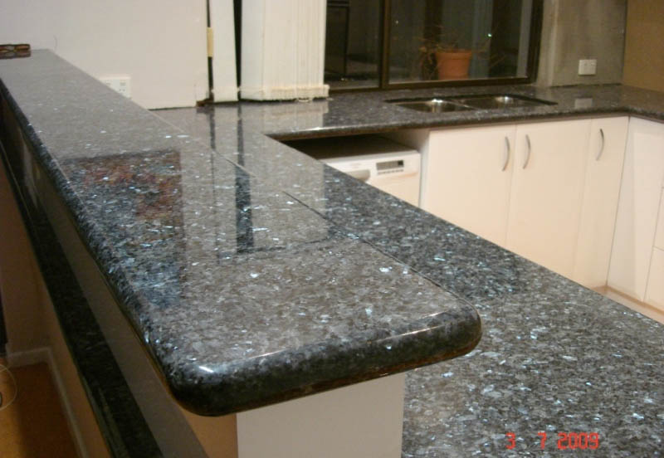
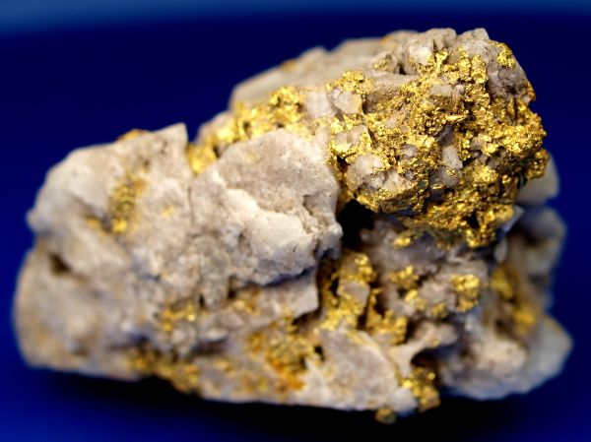
Resource and exploration of mineral resources:
Rocks as resources (Industrial, gold)
Structural vs functional materials
kitchenatquality.com.au
goldrushnuggets.com

Slide 11
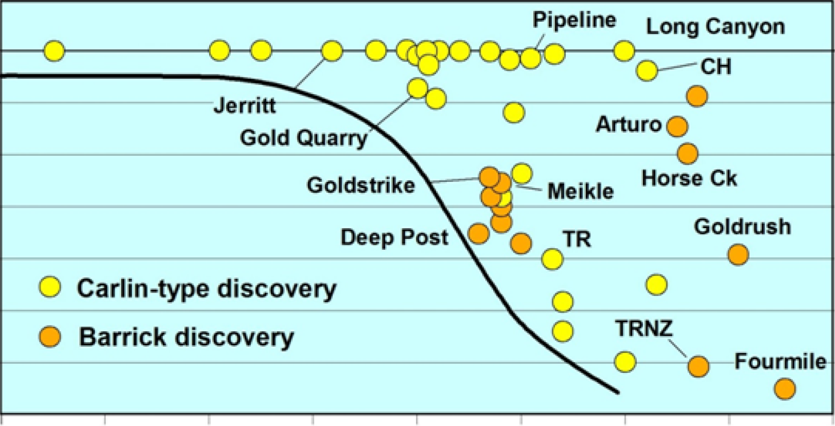
Nevada Gold discoveries
0
200
400
600
Depth (m)
1940 1960 1980 2000 2020
Discovery Year
Source: Barrick

Slide 12
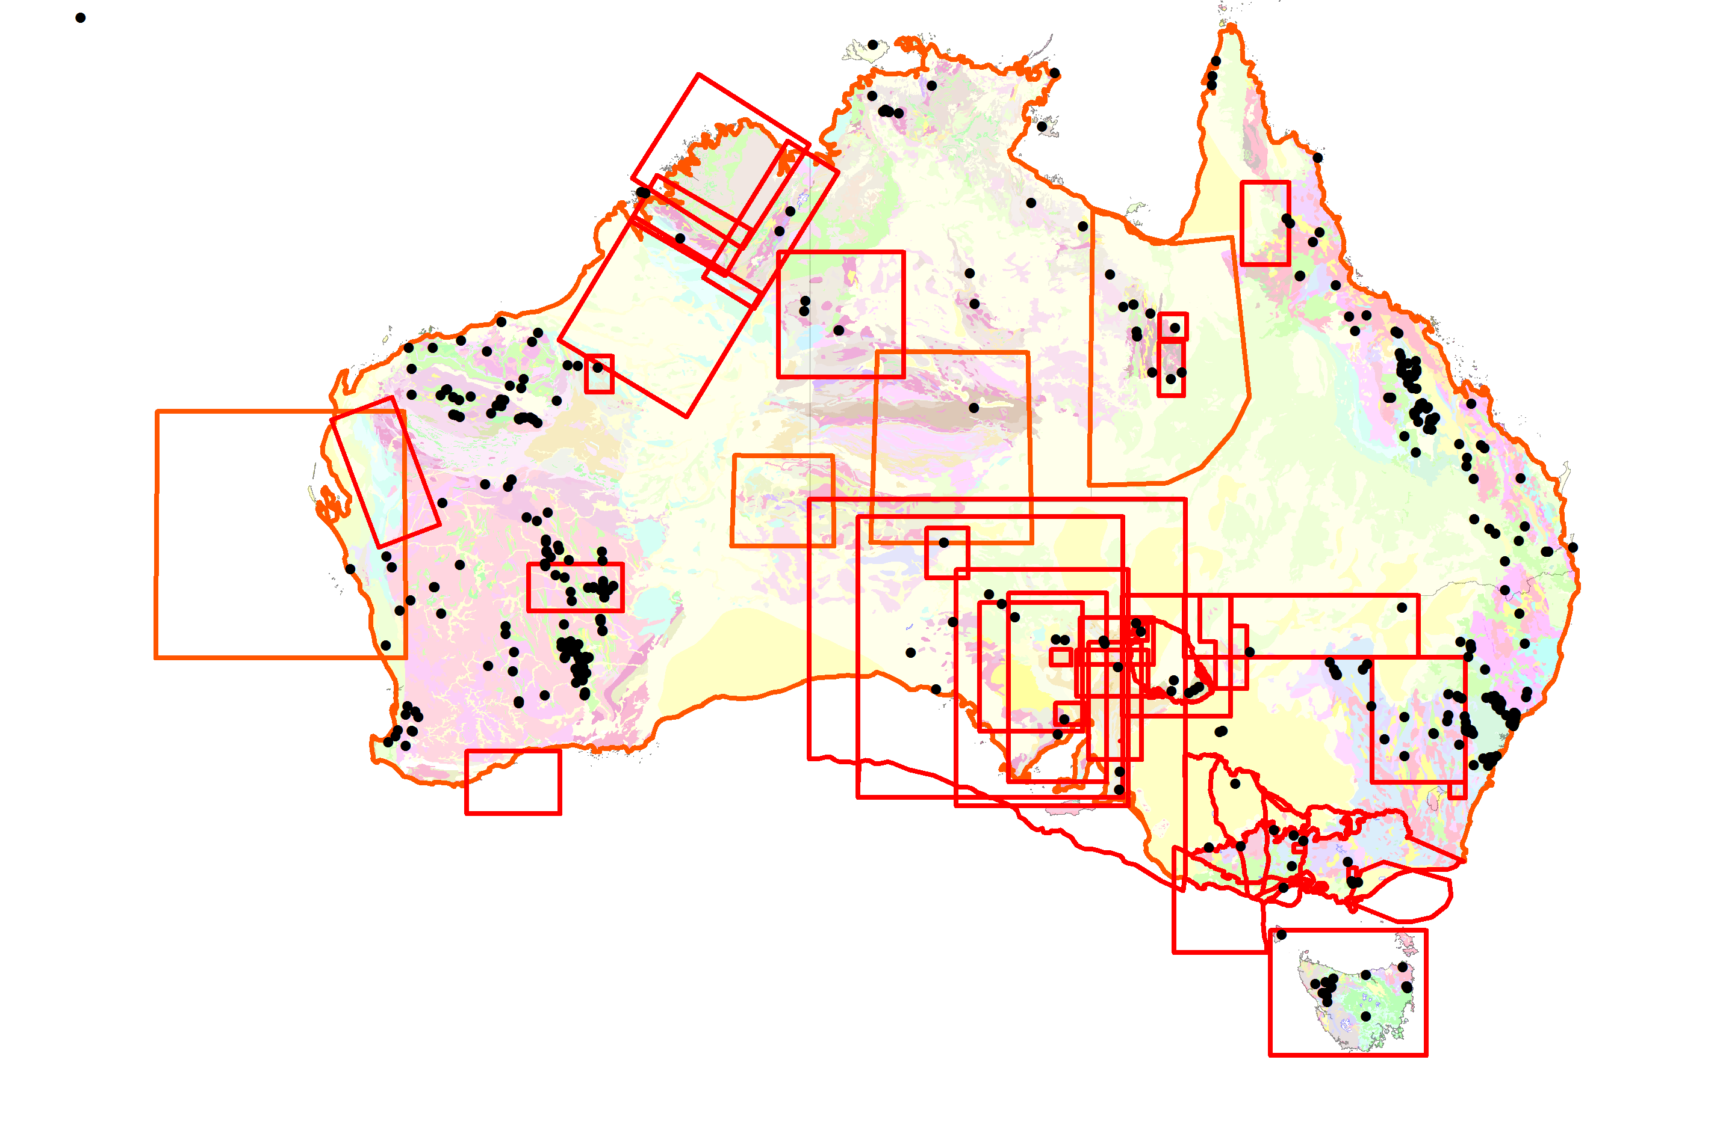
Onshore 3D Models of Australia
Active Mines
Existing or planned 3D models

Slide 13
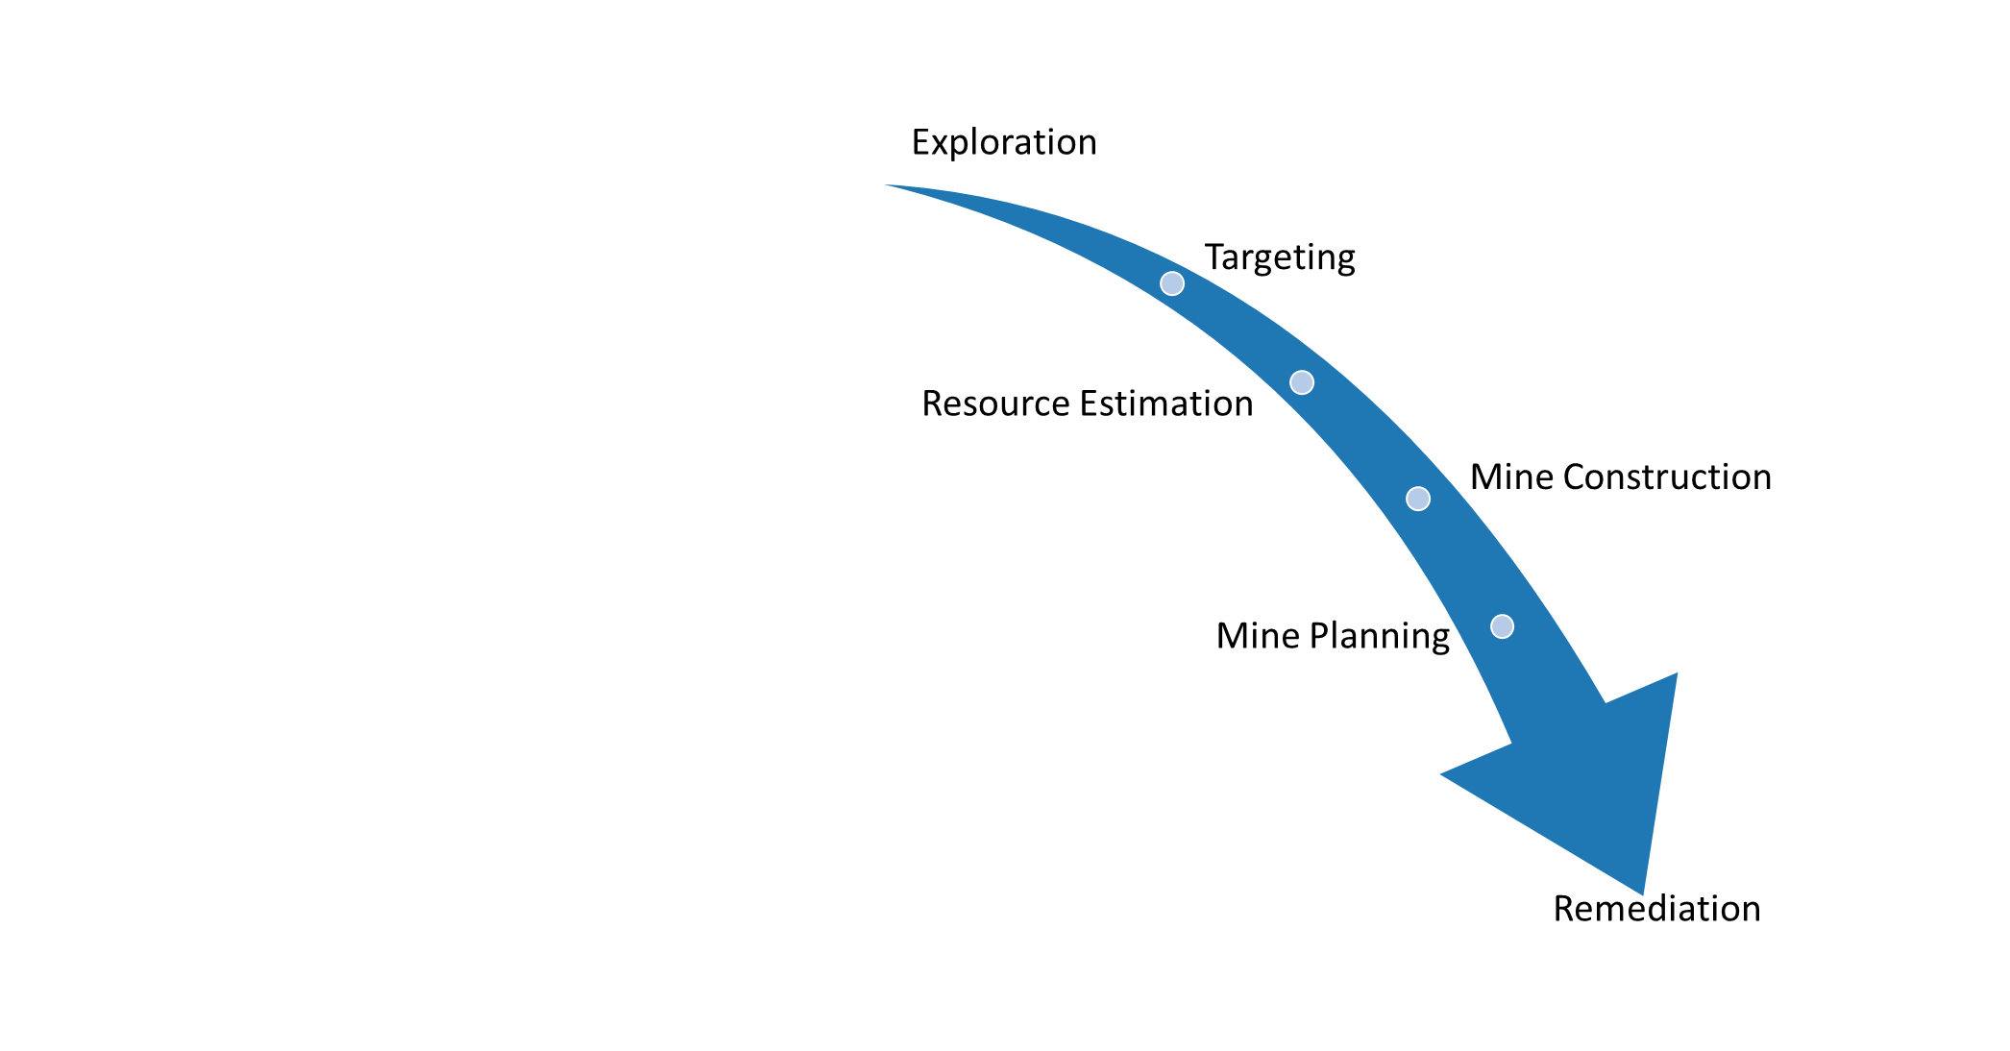
“Premature enumeration”
Different stages of 3D modelling

Slide 14
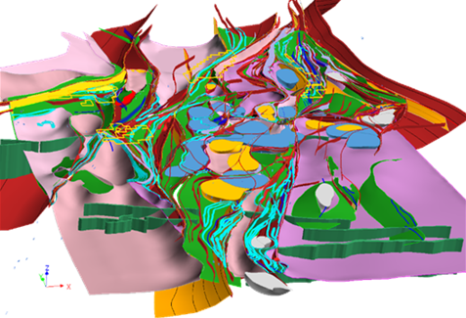
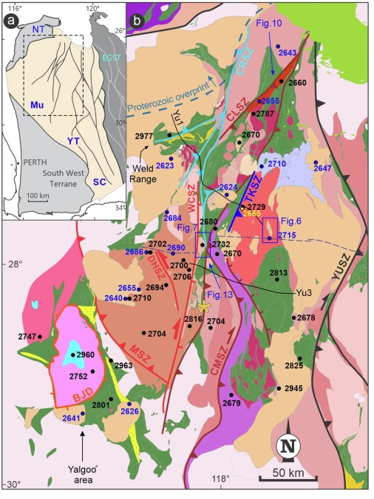
Regional Minerals Exploration
So we need to be able to model:
Distributions of lithology and stratigraphy
Alteration
Petrophysics
Permeability
Fault network
Murchison Province
Zibra, 2020
modelearth.net.au

Slide 15
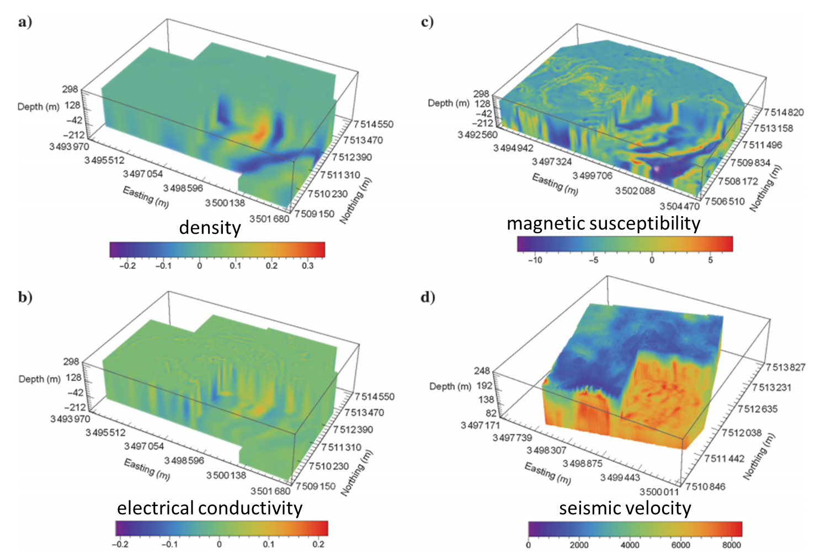
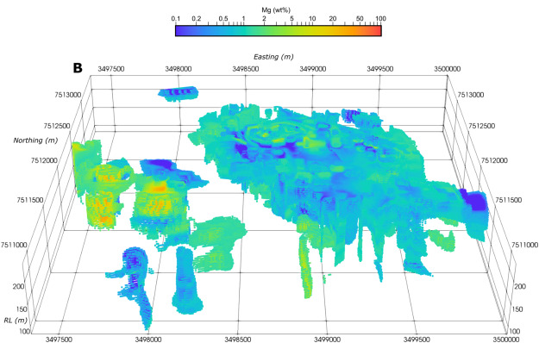
Mine Models – Petrophysics & Chemistry
Kevitsa Mine, Finland
Mg content
Horrocks et al., 2018
Horrocks et al., 2021

Slide 16
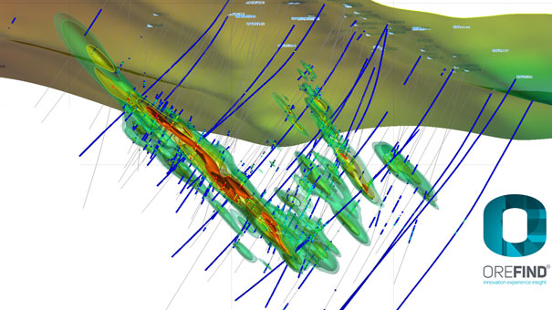
Mine Models - Ore Grade
grade
J. Cowan

Slide 17
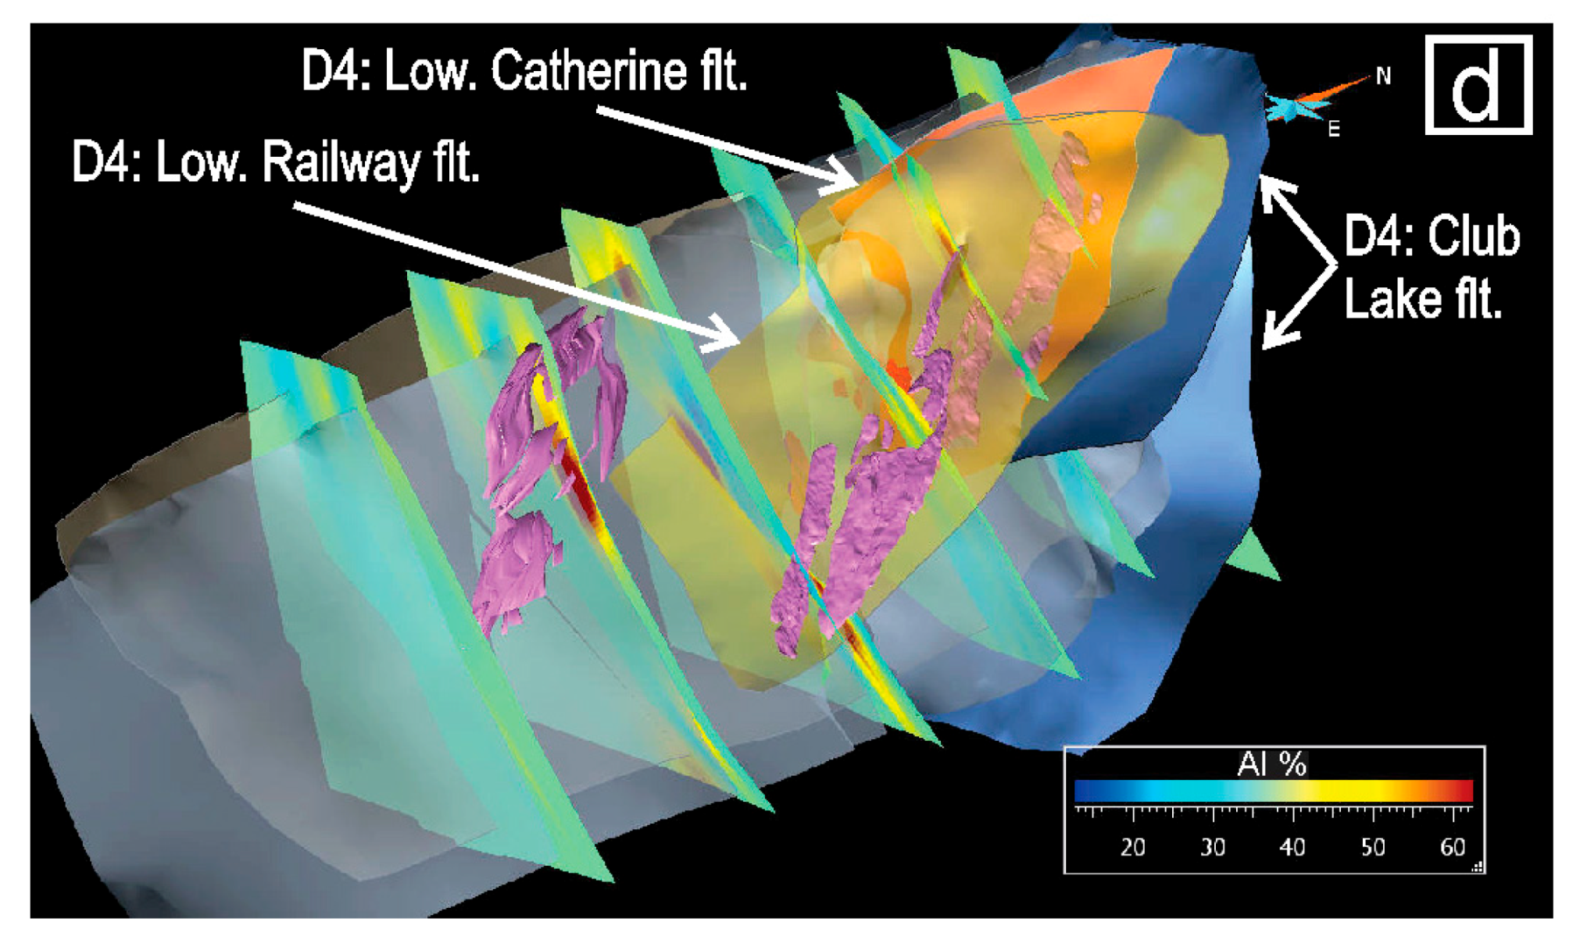
Mine Models - Alteration
Lithology
Structure
Ore
Alteration
Alteration
Ore
Schetselaar et al, 2017 Integrated 3D Geological Modeling to Gain Insight in the Effects of Hydrothermal Alteration on Post-Ore Deformation Style and Strain Localization in the Flin Flon Volcanogenic Massive Sulfide Ore System

Slide 18
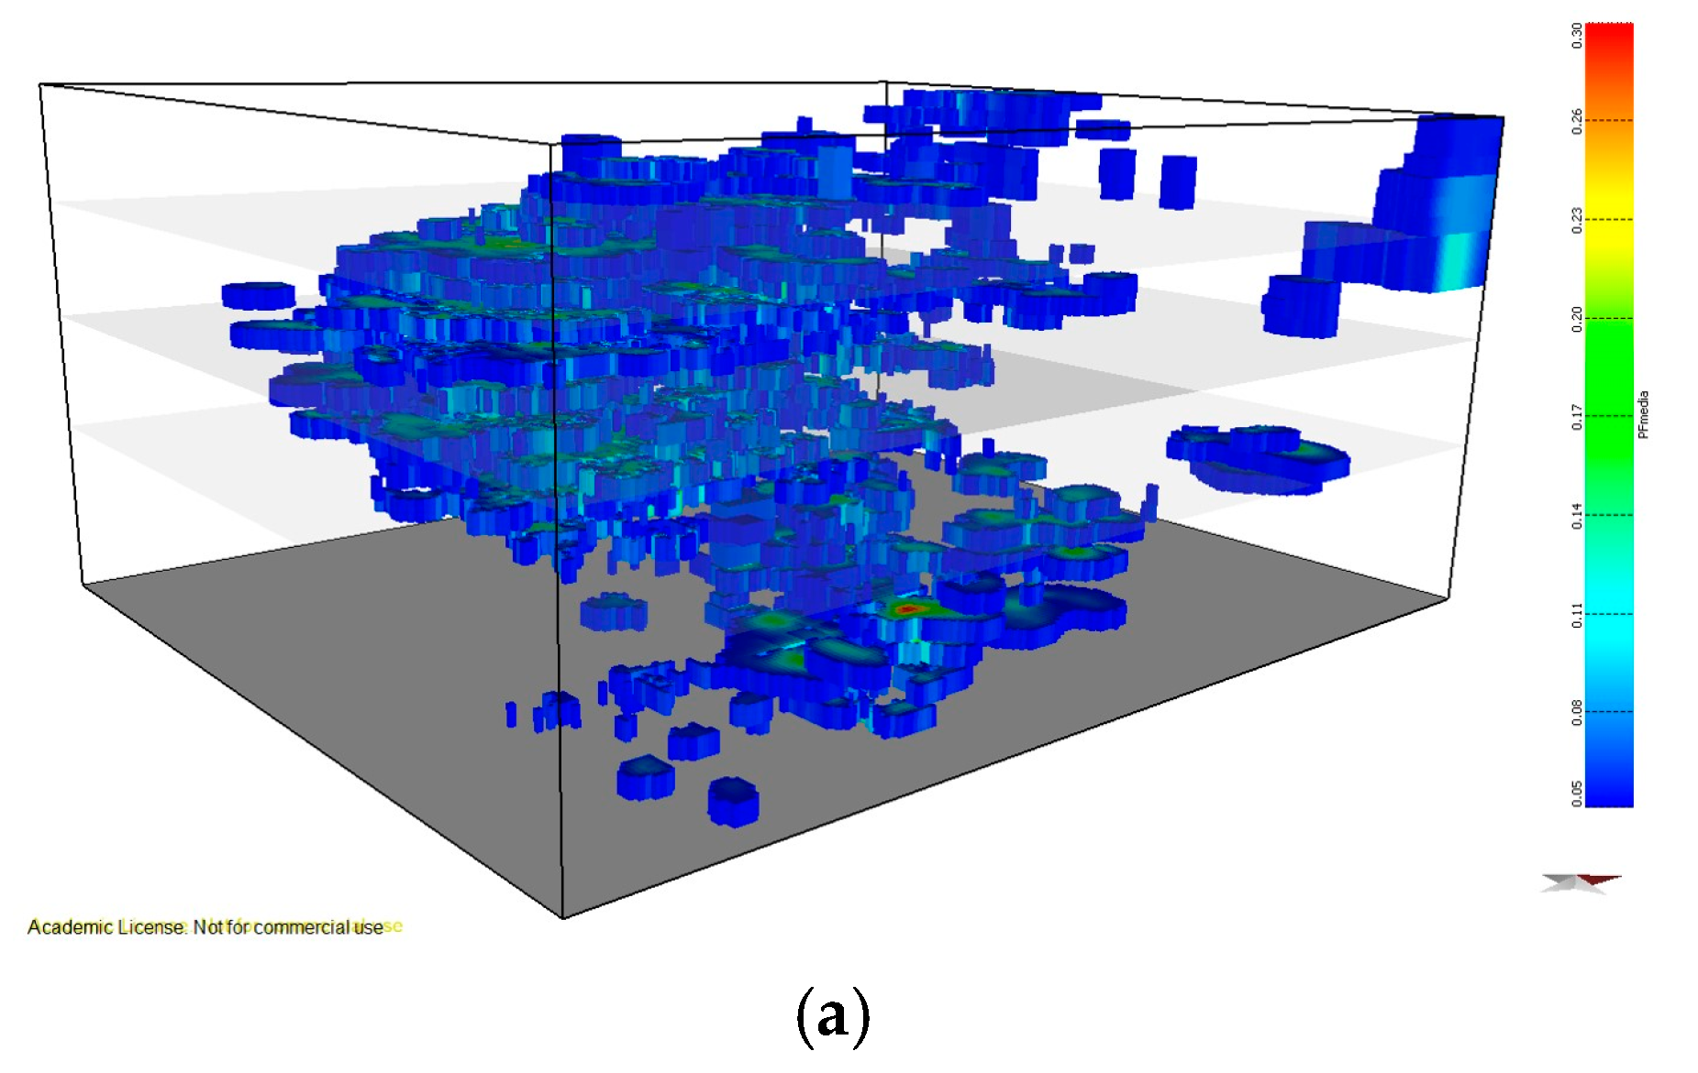
Mine Models – Vein Density
Vein proportion
>5% vein
Sanches et al., 2017. A 3D Geological Model of a Vein Deposit Built by Aggregating Morphological and Mineral Grade Data

Slide 19
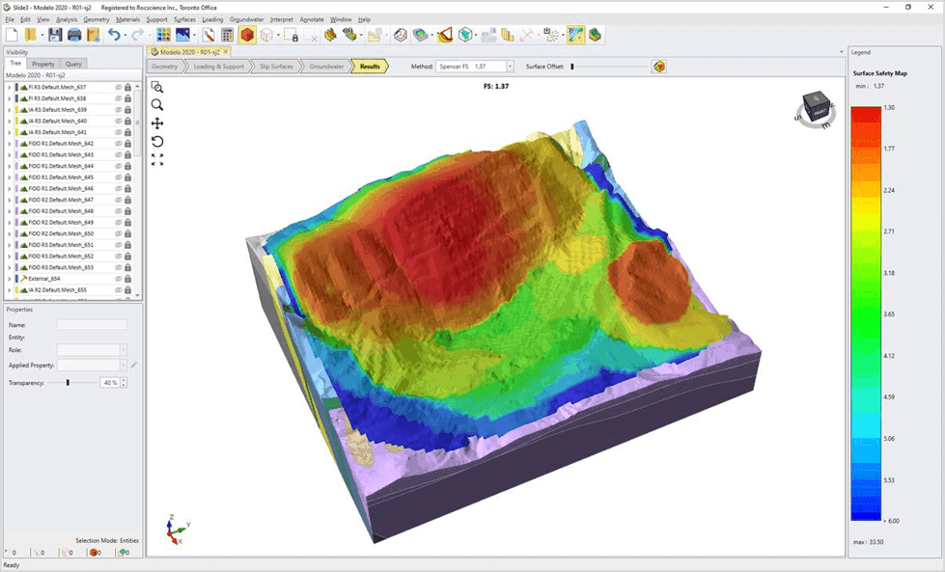
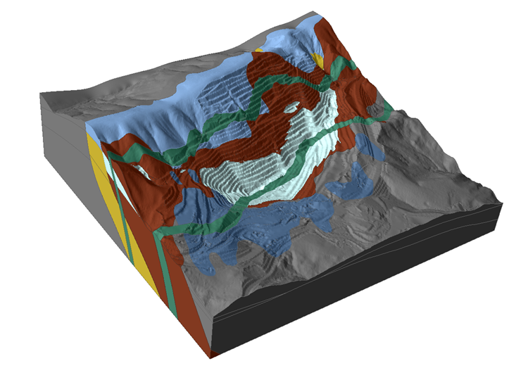
Mine Models – Rock Physics
Young’s Modulus
Shear Modulus
Porosity/permeability
Anisotropy
Surface safety
Slope stability
Bretas and Vilela. www.rocscience.com/

Slide 20
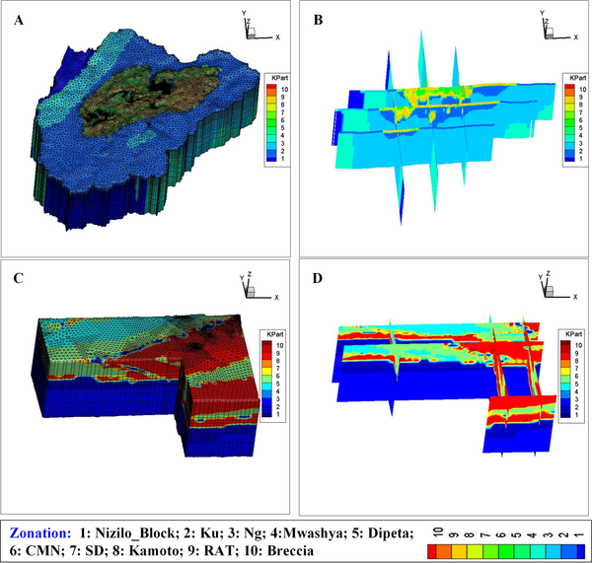
Mine Models - Hydrogeology
Comparison of simulated and observed drawdown in 12 observation wells
Lithology
Permeability
porosity
Hu et al. (2020) Estimating dewatering in an underground mine by using a 3D finite element model. PLOS ONE 15(10): e0239682.

Slide 21
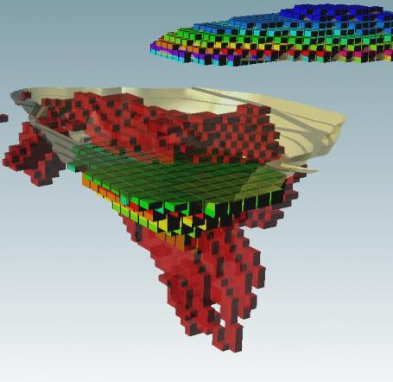
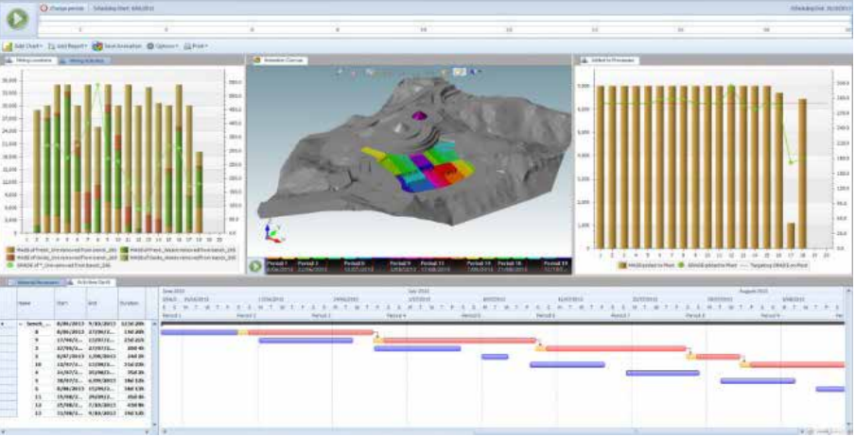

Mine Models - Planning
Block models for mine scheduling
Grade
Geometallurgy
Geomechanical
Lithology

Slide 22
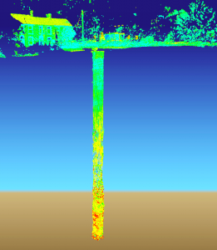
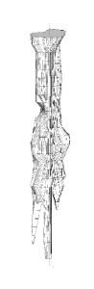
Coal Mine Shaft Remediation
3D Laser Survey
unsaturated upper
saturated lower
Sonar Survey
https://www.earthsciencepartnership.co.uk/projects/remediation-coal-mine-shaft/

Slide 23
Even if we restrict ourselves to models associated with minerals we have significant variations in what defines our 3D model:
Property
Chemistry
Ore Grade and Geometallurgy/ Microstructure
Mineralogy/ Alteration
Lithology and Stratigraphy
Petrophysics & Rock physics
Structures & Structure density
Description of property
Surfaces
Block Models
Iso-surfaces
Connectivity
Scale

